Slide 1
ChatGPT for Teachers
Welcome!
#MNCODES

Slide 2
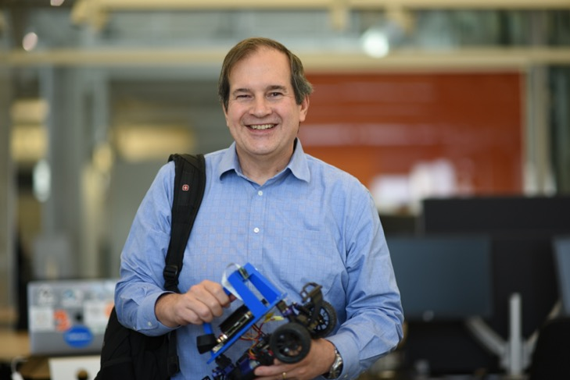
Dan McCreary
He/him
Code Savvy/Optum
Contact: https://www.linkedin.com/in/danmccreary/

Slide 3
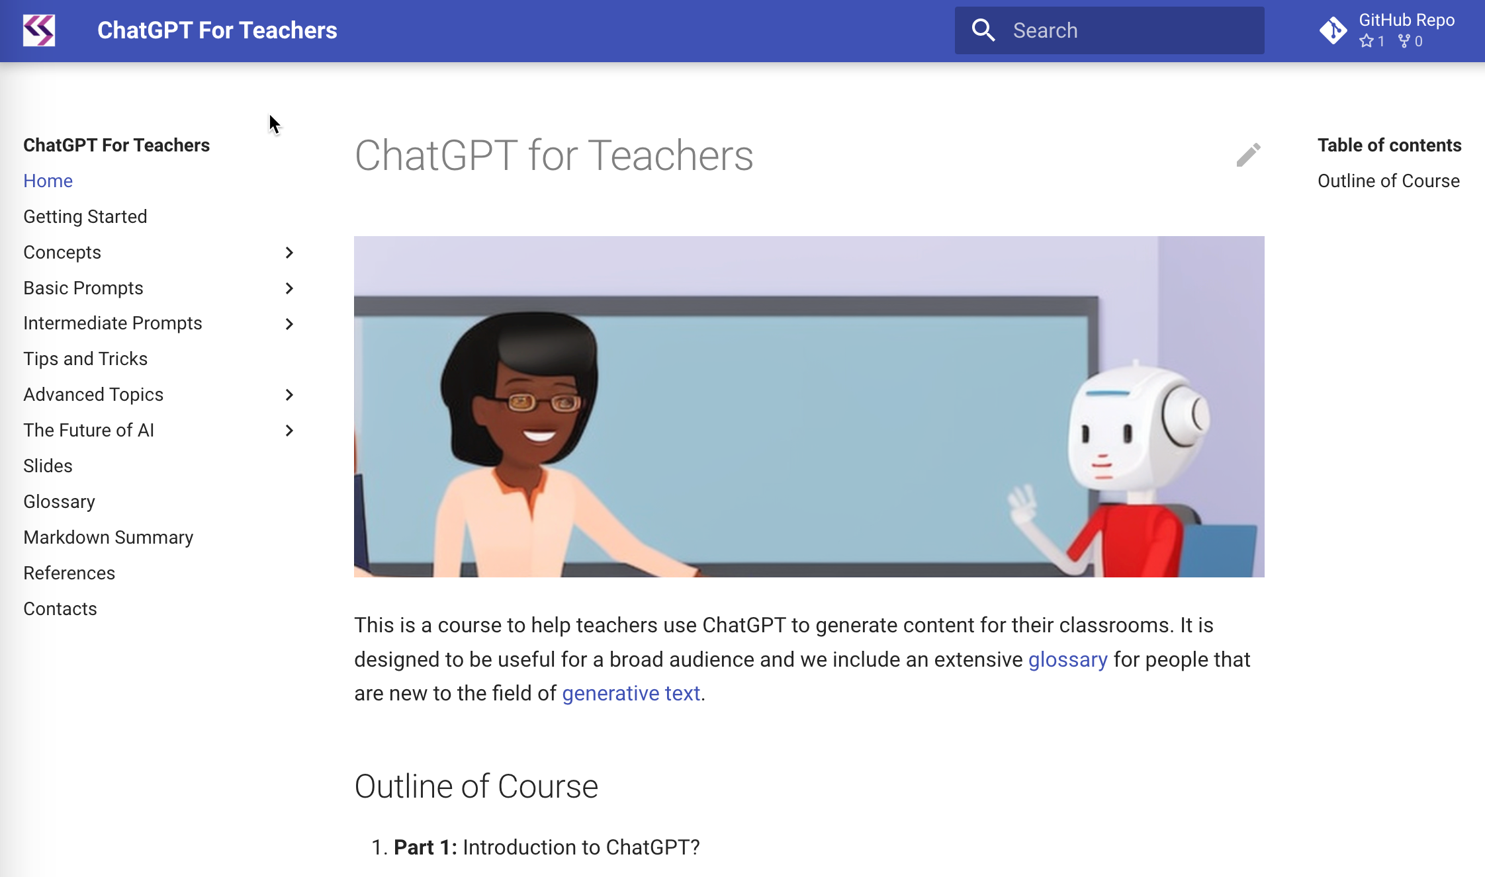
Supporting Website
ChatGPT for Teachers
http://www.coderdojotc.org/chatgpt-for-teachers/
Search
GitHub
Navigation

Slide 4
Agenda
Ethics 1st: When should we use technology and AI in the classroom?
What is ChatGPT and generative AI?
Examples
Computational thinking topics
Code of conduct lab
Generating “hands on” interactive examples
Explaining linear regression
Generating stories and using metaphors and analogies
Future Direction
Ethics last: wrap-up

Slide 5
Content Licenses
All content presented is my own original content with some portions of text and code generated by ChatGPT
Images are generated by Stable Diffusion 2.1 with editing
You are welcome to reuse all the examples in your classrooms with the following constraints
Acknowledgement is always appreciated
You can’t resell this content for profit

Slide 6
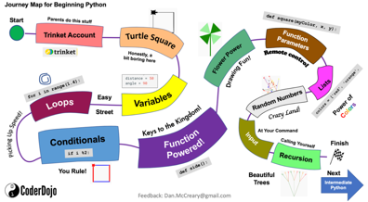
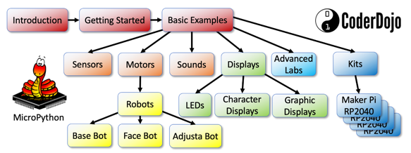
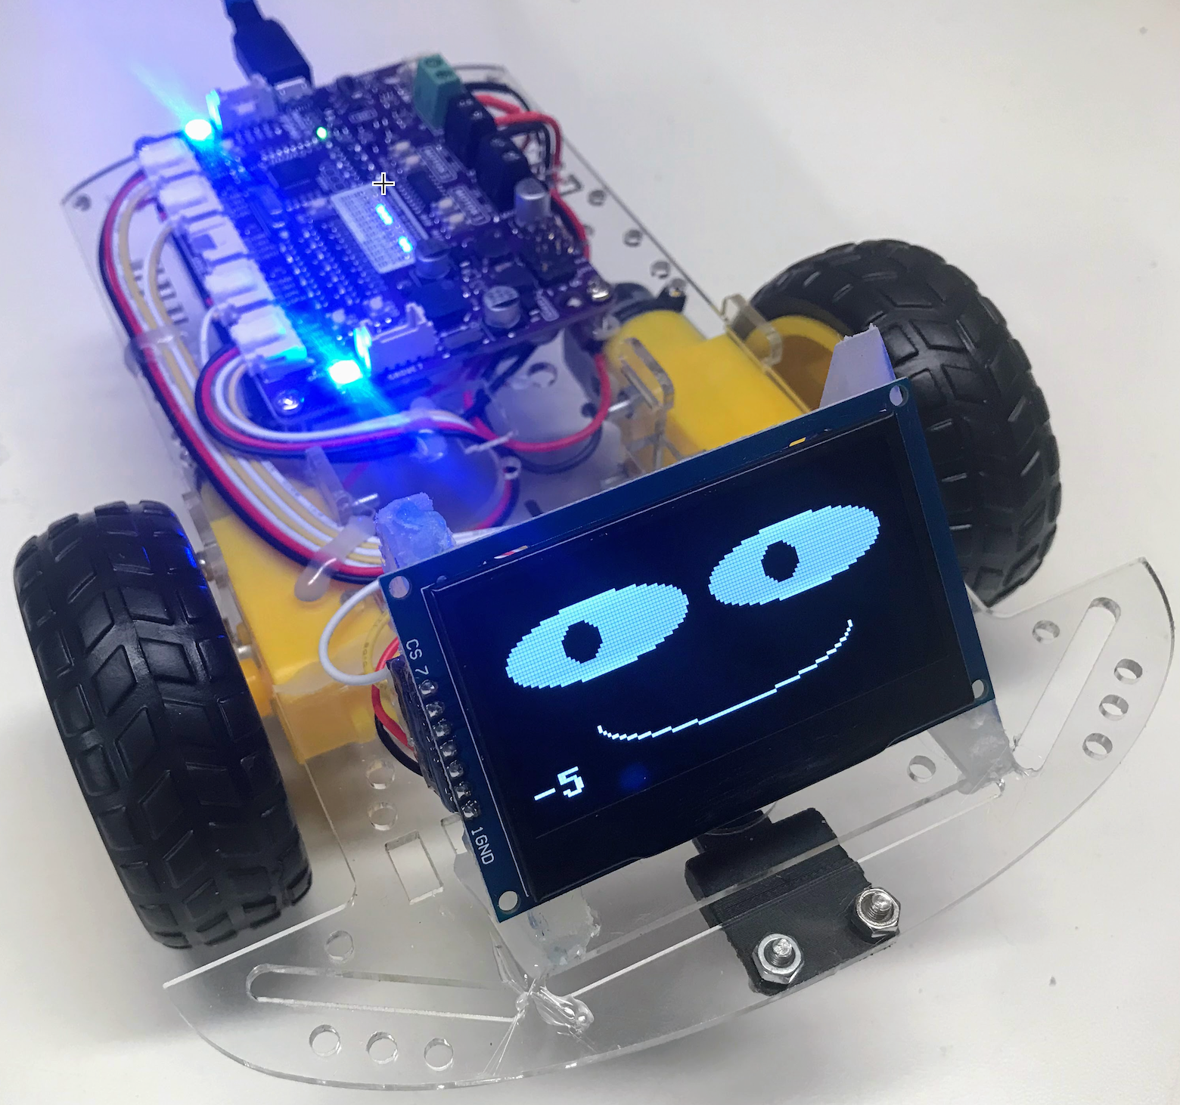
About Me
Teaching Computational Thinking since 2014
CoderDojo / Code Savvy / Optum Robots
Day job: Distinguished Engineer at Optum Technology
Lead the “ChatGPT Center of Good”
Champion of Shared Lesson Plans for Girls/Disadvantaged Youth
Python
MicroPython
$19 Robot

Slide 7
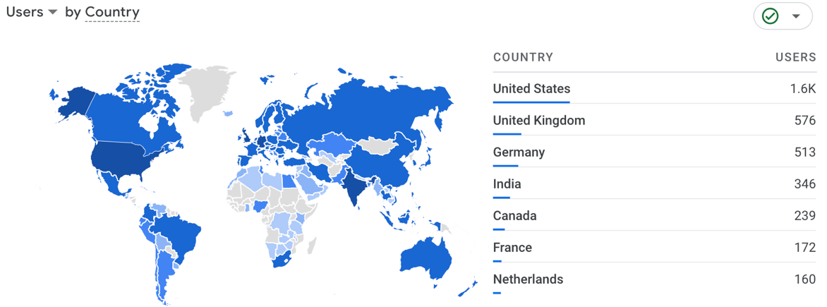
Over 10K Users in 97 Countries
MicroPython site usage over prior 90 days (Google Analytics)

Slide 8
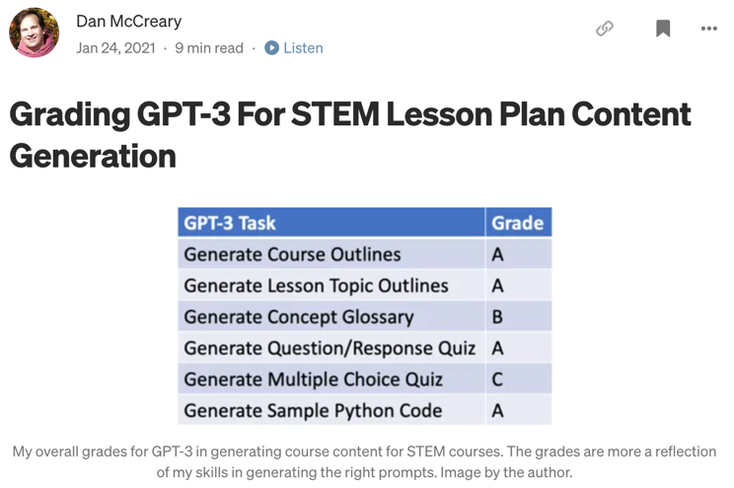
Blog Published in January 2021
Nov. 2022
GPT-4?
ChatGPT
A
A
A
A
B
A
GPT-3 only got “A”s in 4 out of 6 challenges
ChatGPT (Nov. 30th, 2022) would get all “A”s – 18 months

Slide 9
Ethics of Generative AI
When is it ethical to use:
Calculators in the classroom
E-Mail vs. hand-written notes
Wikipedia to do research vs going to your local library
Google search for sample code
Spell checkers
Writing aids (Grammarly)
Outline generators
Full generative text
When should we disclose our use of these tools?
When are we avoiding interpersonal contact when using these tools?

Slide 10
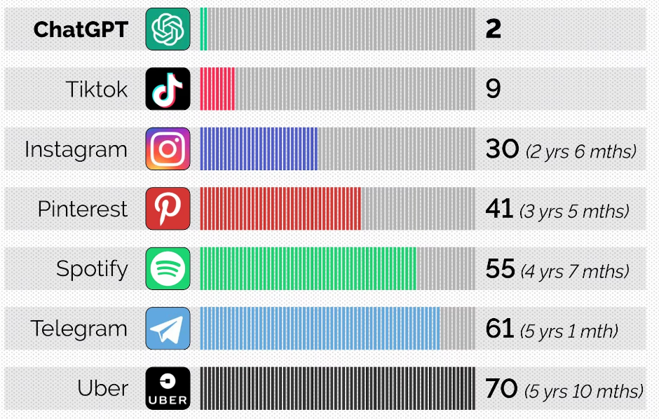
Fastest Time to 100M Users
Source: CNBC
Notes:
https://www.cnbctv18.com/technology/chatgpt-sets-record-for-fastest-growing-user-base-says-study-15840751.htm

Slide 11
What is ChatGPT?
Large
Language
Model
Prompt
Output
A type of “Generative AI”
Built on large-language models (LLMS)
Text to Anything
Text to images
Text to software code
Text to interactive graphics
Input: Prompt
Instructions on what you want
Examples of the format you want it
Description of your audience (For a 5th grade class)
The style or perspective you want to take
Output: What you want to generate
Documents, letters, outlines, code, stories, metaphors

Slide 12
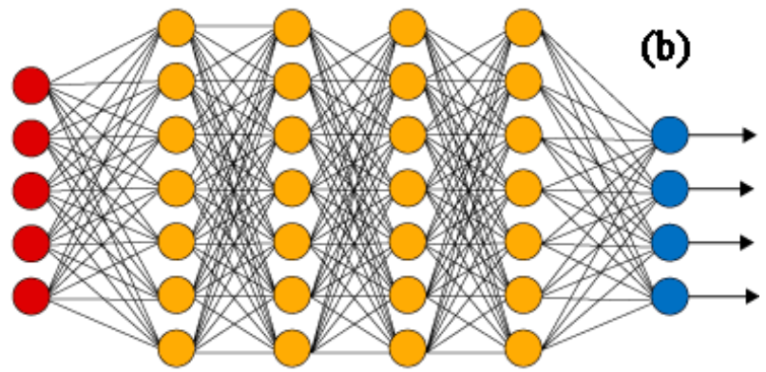
Large Language Model: What is the next token?
Input
Prompt
Next
Token
Input prompts are input to a neural network and are used to predict the next word (token).

Slide 13
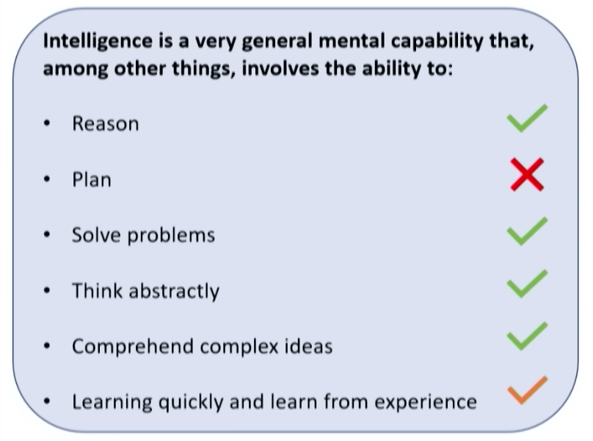
Is GPT “Intelligent”?
Is this still true after AUTO-GPT?
Annual updates
https://youtu.be/qbIk7-JPB2c?t=1000

Slide 14
ChatGPT for Teachers
Pros
Many tasks can be semi-automated
Story: Teaching made easy with ChatGPT!
Lesson planning, grading, and writing comments to parents are now automated, reducing stress by 95%.
Cons
No easy way to tell when ChatGPT is telling the truth
Verification can take time
Notes:
https://www.reddit.com/r/ChatGPT/comments/12a3b9z/chatgpt_as_a_teacher_where_have_you_been_all_of/

Slide 15
What is Computational Thinking?
Prompt: What are the key concepts in teaching computational thinking?
Response:
Decomposition: Breaking down complex problems …
Abstraction: Focusing on the essential details and ignoring non-essential details.
Pattern recognition: Identifying common patterns in data…
Algorithmic thinking: Developing a step-by-step process…
Debugging: Finding and fixing errors in code or algorithms.
Automation: Using computers and algorithms to automate tasks…
Data analysis: Collecting, organizing, and analyzing data…
Computational creativity: …develop new and innovative solutions to problems.

Slide 16
What is Computational Thinking? Full Response
Computational thinking refers to the mental processes used by computer scientists and programmers to solve problems and create algorithms. Here are some key concepts that can be useful in teaching computational thinking:
Decomposition: Breaking down complex problems into smaller, more manageable parts or sub-problems.
Abstraction: Focusing on the essential details and ignoring non-essential details.
Pattern recognition: Identifying common patterns in data or problems and developing solutions based on those patterns.
Algorithmic thinking: Developing a step-by-step process or algorithm for solving problems.
Debugging: Finding and fixing errors in code or algorithms.
Automation: Using computers and algorithms to automate tasks that would otherwise be time-consuming or difficult for humans.
Data analysis: Collecting, organizing, and analyzing data to extract meaningful insights.
Computational creativity: Using computational thinking to develop new and innovative solutions to problems.
When teaching computational thinking, it is important to emphasize these concepts and provide opportunities for students to practice them through hands-on activities, projects, and challenges.

Slide 17
Have Students Draft Their Own Code of Conduct
Prompt: Create a code of conduct for a junior high school classroom.
Include topics of values, diversity and respect.
Return the results in markdown format.
Discussion: when is it ethical to have ChatGPT help you write a letter to parents about interventions?

Slide 18
Code of Conduct
Prompt: Create a code of conduct policy for a 9th grade programming class
Response:
Respectful Behavior
Academic Honesty
Attendance and Participation
Use of Technology
Completion of Assignments
Respect for Property
Communication
Safety
Consequences
Discussion Question: Can generative AI help us create a more ethical society?

Slide 19
Pick a License for Your Lesson Plans
Prompt: I am a teacher that is creating new lesson plans. I want other teachers to be able to reuse my content and modify it for their classrooms. However, I want them to give me attribution and I don't want anyone to be able to resell my content.
Response: The Creative Commons Attribution Non-Commercial Share-Alike 4.0 International (CC BY-NC-SA 4.0) license would be the best option for you. …
Details: http://www.coderdojotc.org/chatgpt-for-teachers/prompts/03-license/

Slide 20
Lesson Plan Prompt
Design a lesson plan about topic A with B goals, C accommodations, and D time limit. Finally, to do E and F differentiation, and accommodating students with G, H, and I special needs.
30 seconds later a perfectly worded lesson plan appears before me. I could do that myself, but it could take an hour. What would take me an hour before now takes mere seconds.
Source: Redditor SquatDeadliftBench on April 2nd, 2023 – 470+ comments

Slide 21
Generating Coding Lesson Plans
Prompt: Create a detailed lesson plan for teaching loops in Python
for a junior high-school student about 12 years old.
Assume the student has already had a basic introduction
to Python and has had lessons on:
1. Syntax
2. Conditionals
Generate sample Python code within markdown that will include
an input list of colors (red, green blue etc.) and show how
to loop through the list of colors to print them each out.
Results: http://www.coderdojotc.org/chatgpt-for-teachers/prompts/06-lessons/

Slide 22
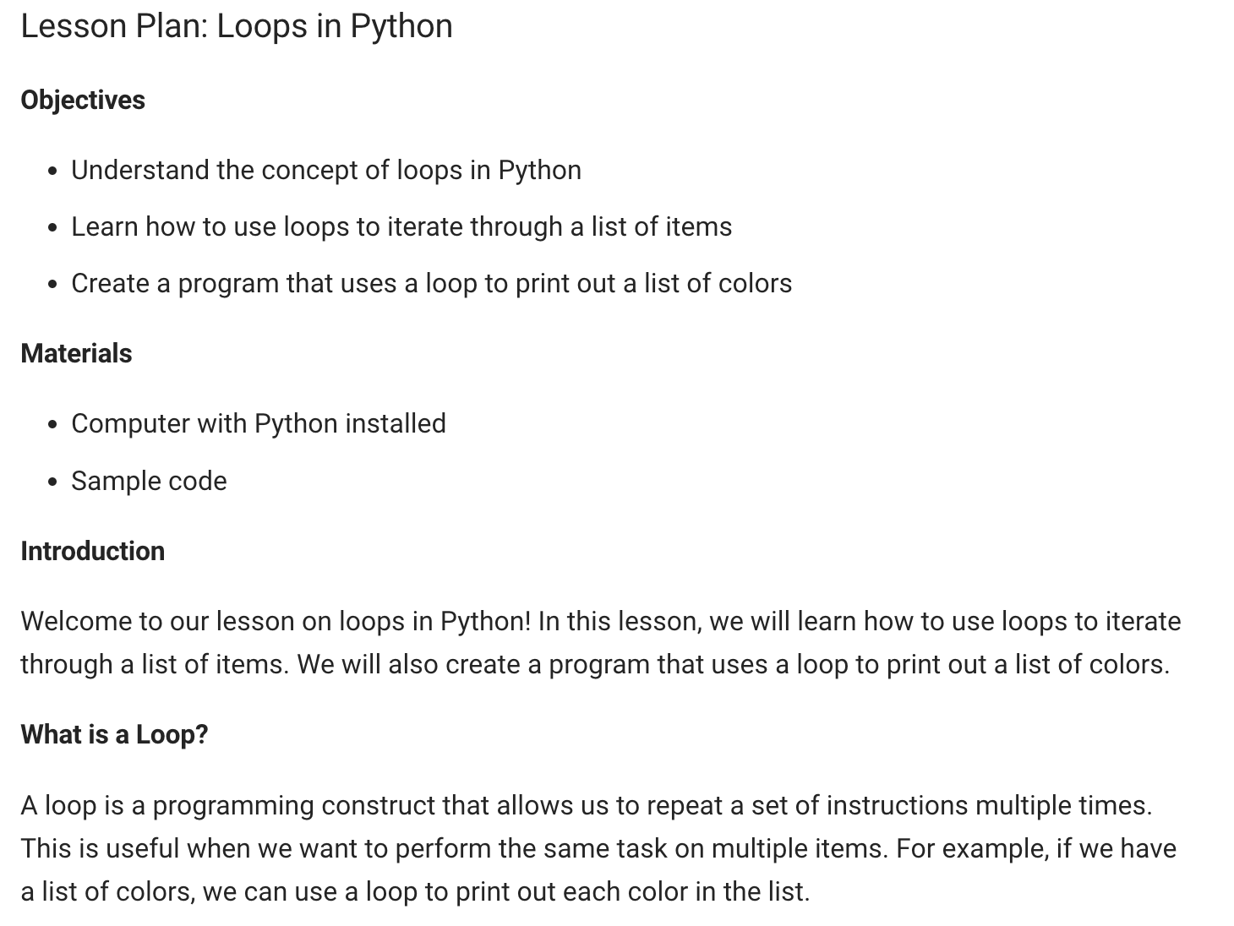
Sample Response

Slide 23
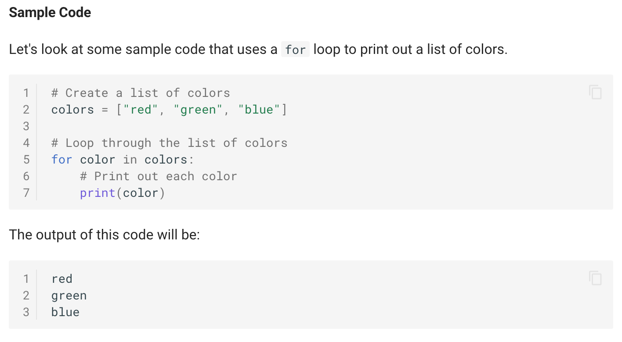
Sample Response (continued)

Slide 24
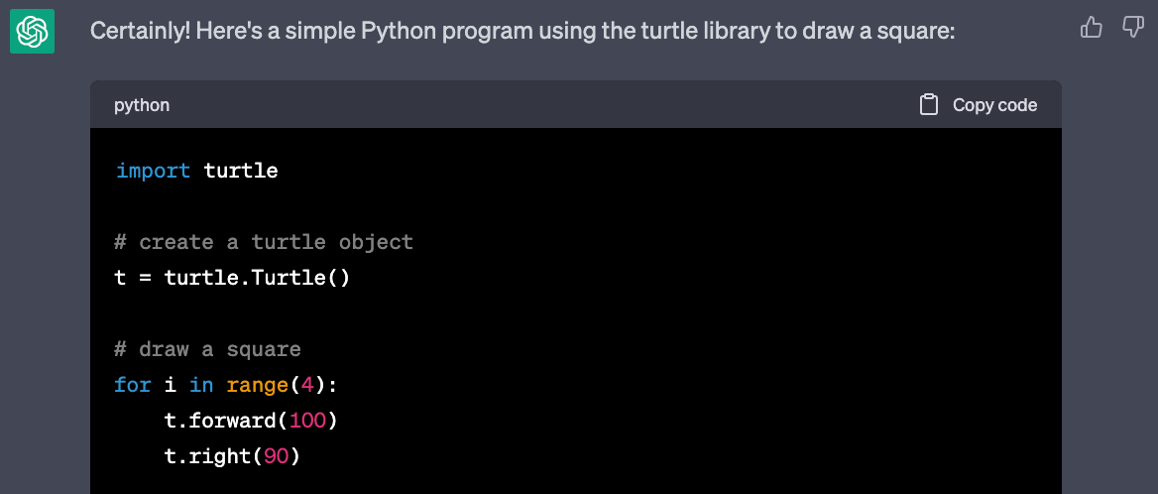
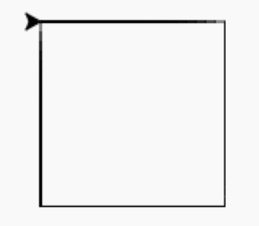
Generating Sample Code
Prompt: Create a Python program using the turtle library to draw a square.
Copy code and paste into Trinket.io
https://trinket.io/library/trinkets/ea571870b9

Slide 25

Rainbow Boxes
Prompt: Generate a sample python program using the turtle library that will draw 7 boxes filled with the colors of the rainbow. Start at (-200,0) and make the boxes 50 on each side. Space the boxes 55 apart.
Don't bother with the setup including screen size, background color and title.

Slide 26
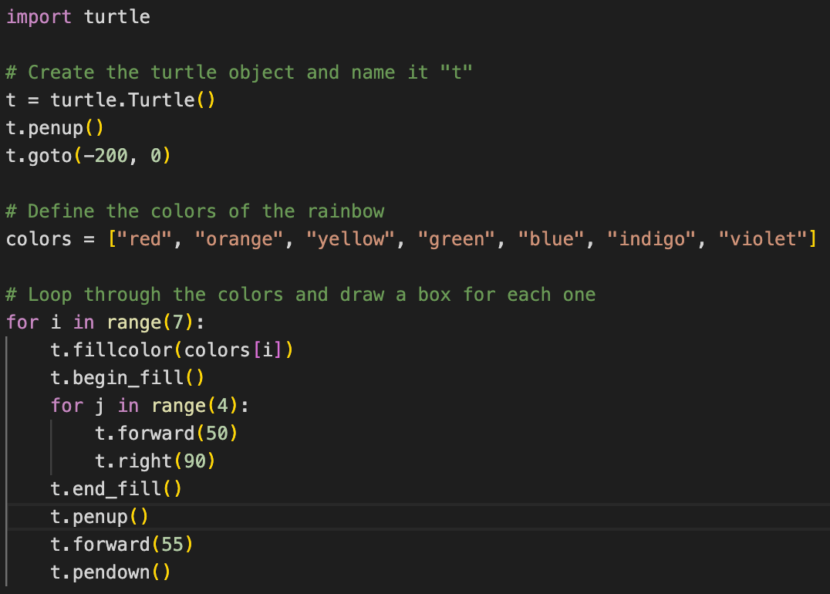
Rainbow Boxes Source

Slide 27
Listing Common Misunderstandings
List the most common ways that high school computer science students misunderstand concept X. For each way, briefly explain what students may erroneously think, then give the correct understanding.

Slide 28
Common Misunderstandings about Objects
Prompt: List the most common ways that high school computer science students misunderstand concept object-oriented programming. For each way, briefly explain what students may erroneously think, then give the correct understanding.
Confusing classes with objects
Not understanding inheritance
Not grasping the concept of encapsulation
Not understanding polymorphism
Not fully understanding the concept of abstraction
To overcome these misconceptions, students should focus on understanding the fundamental concepts of object-oriented programming and practice writing code that uses these concepts. They should also seek help from teachers, tutors, or online resources if they need further clarification.

Slide 29
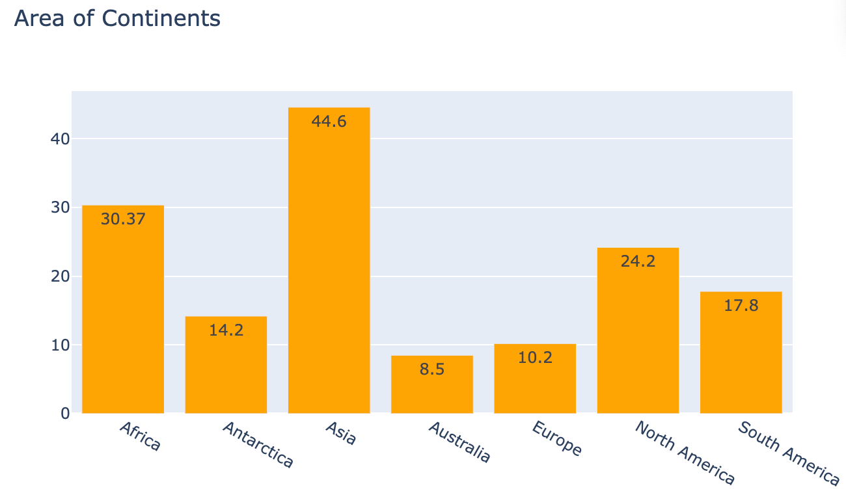
Simple Charts
Prompt: Create a Python plotly program to draw a vertical bar chart showing the area of all the continents.
I use Visual
Studio Code
Configure
Copy Code
Run

Slide 30
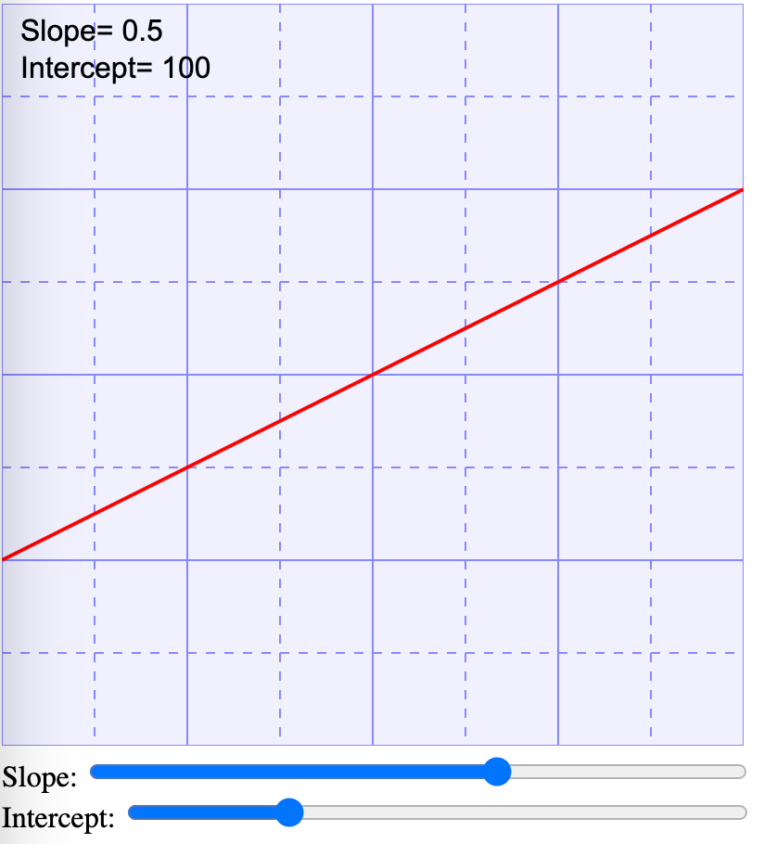
Generating Interactive “Hands-On” Labs
Prompt: Create an interactive web application that demonstrates the slope and intercept concepts. Create two range sliders for slope and intercept
Interactive Controls!
http://www.coderdojotc.org/chatgpt-for-teachers/prompts/10-slope-and-intercept/

Slide 31
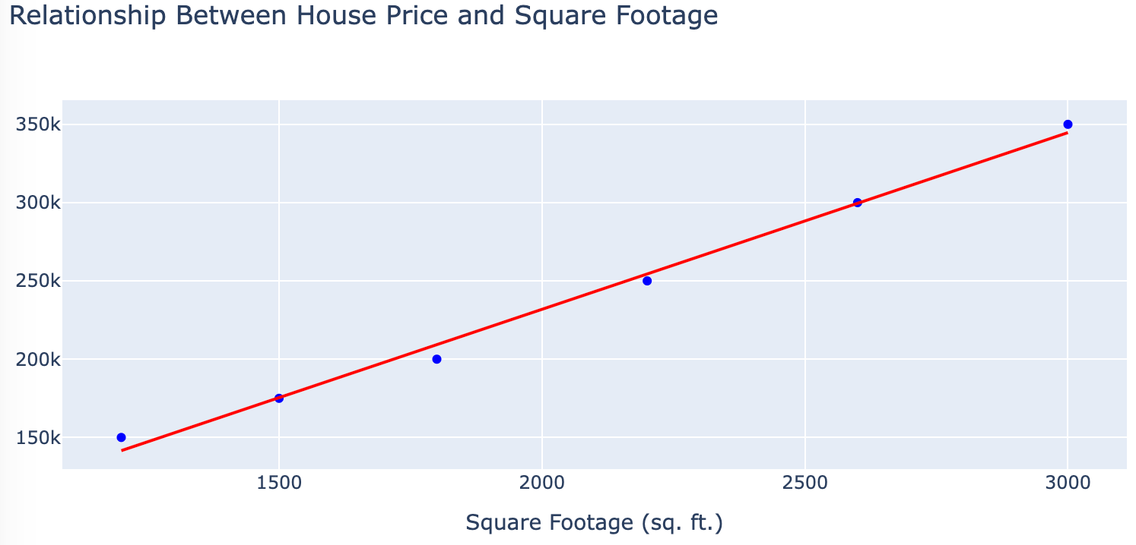
Teaching Linear Regression
Linear regression is the “gateway” to prediction and AI

Slide 32
Slope and Intercept Lab
Prompt:
Generate an interactive HTML page using JavaScript and SVG.
Create a 400x400 cartesian grid with (0,0) in the lower left corner.
Add 8 points with x spaced evenly every 50 pixels.
Make the y values for each point be within 20 pixels of the equation y = 2x +50
Add a least square fit line through the points.
Add an input range controls that allows the user to vary the slope and intercept.

Slide 33
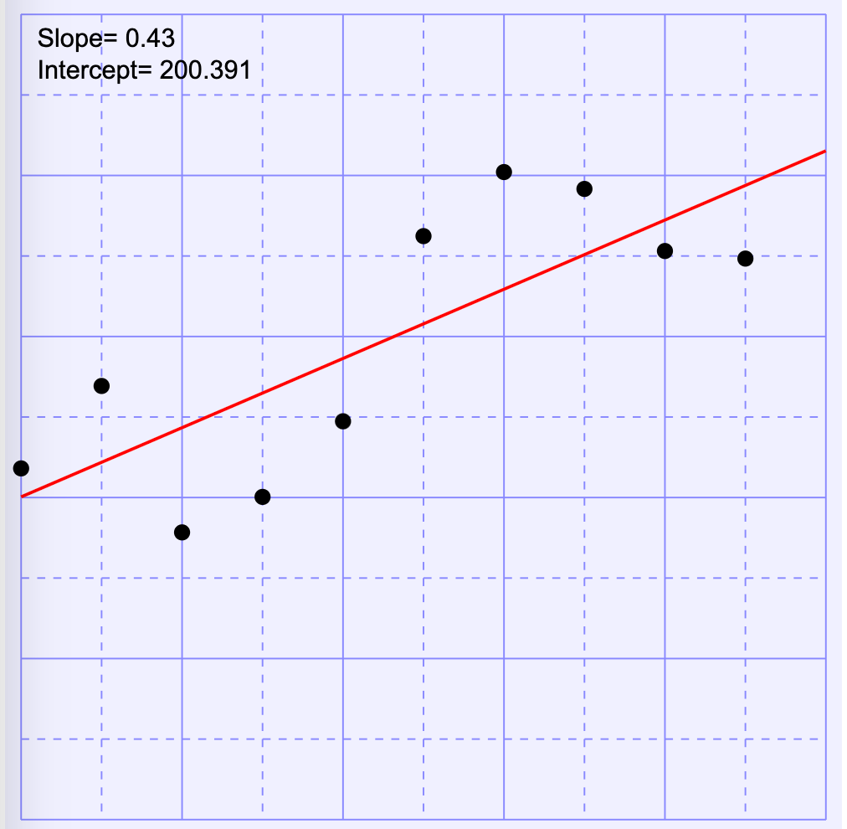
Least Square Fit

Slide 34
Teaching Using Metaphors, Analogies and Stories
Prompt: Use an analogy to explain linear regression
Explain X so that a 5th grader can understand.
I would have never expected ChatGPT to be able to write analogies so well.
I like to get ChatGPT to explain difficult concepts as a dialogue between two characters.
I like to have ChatGPT make little rhyming poems of concepts to make them easier to remember.

Slide 35
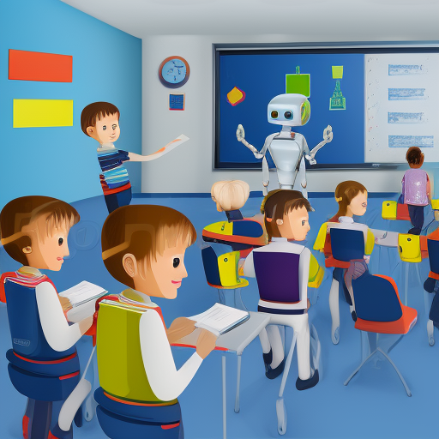
Future
Generative AI is in its infancy
Performance is doubling every 8-months
There are over 9,000 generative AI models (see HuggingFace.io)
GPT-4 has much higher quality and can analyze up to 32K tokens
New innovations weeks apart
LangChain
Auto-GPT
The pace of change is accelerating

Slide 36
Historical Perspective
Other
AI
The “generative turn”
Large language models move to the center of information systems integration
Agents speak in natural language, not APIs
Generative
AI
2022

Slide 37
In The Next Few Years
Prompt: Create a lesson plan for each of my students on linear regression. Adjust the complexity of the lesson to how students did on the prior quiz. Send the lessons out via e-mail with a return deadline of tomorrow at 5pm. Generate a multiple-choice quiz adjusted to each lesson. Send the quiz out the following day at 8am and have the results go into our Learning Management System. Analyze the results. Send the resulting reports to my email.

Slide 38
Ethical Considerations
When is it appropriate to automate the tedious parts of teaching
How can these tools allow you to spend more time with your students?
When is it appropriate for us to disclose our use of these tools to our peers, parents and students?
Will AI use bias if they know the gender or race of a student?
When should these tools be regulated?

Slide 39
Thank You!
Dan McCreary
Contact: https://www.linkedin.com/in/danmccreary/

